Slide 1
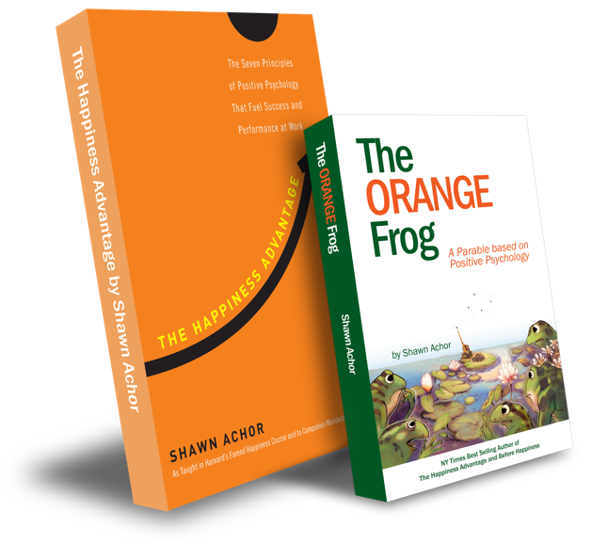
Conscious
Acts Of
Kindness

Slide 2
Week Four
“Be the reason someone believes in Good People.”

Slide 3
I can reflect back on my 21-day challenge and determine the importance of the “CAOK tactic”.
I will discuss the importance of being able to look back and decide where the tactic had an impact on my life or not
When you have a bad day, a really bad day, try to treat the world better than it treated you.
Notes:
Standard:
Essential Concept and/or Skill: Communicate and work productively with others emphasizing collaboration and cultural awareness to produce quality work.
Interact positively as a team member.
Cooperate with others in a group setting.
Generate ideas with group members.
Are active listeners.
Read and understand information in a variety of forms.
Express ideas.
Skill:
Active listening, express ideas

Slide 4
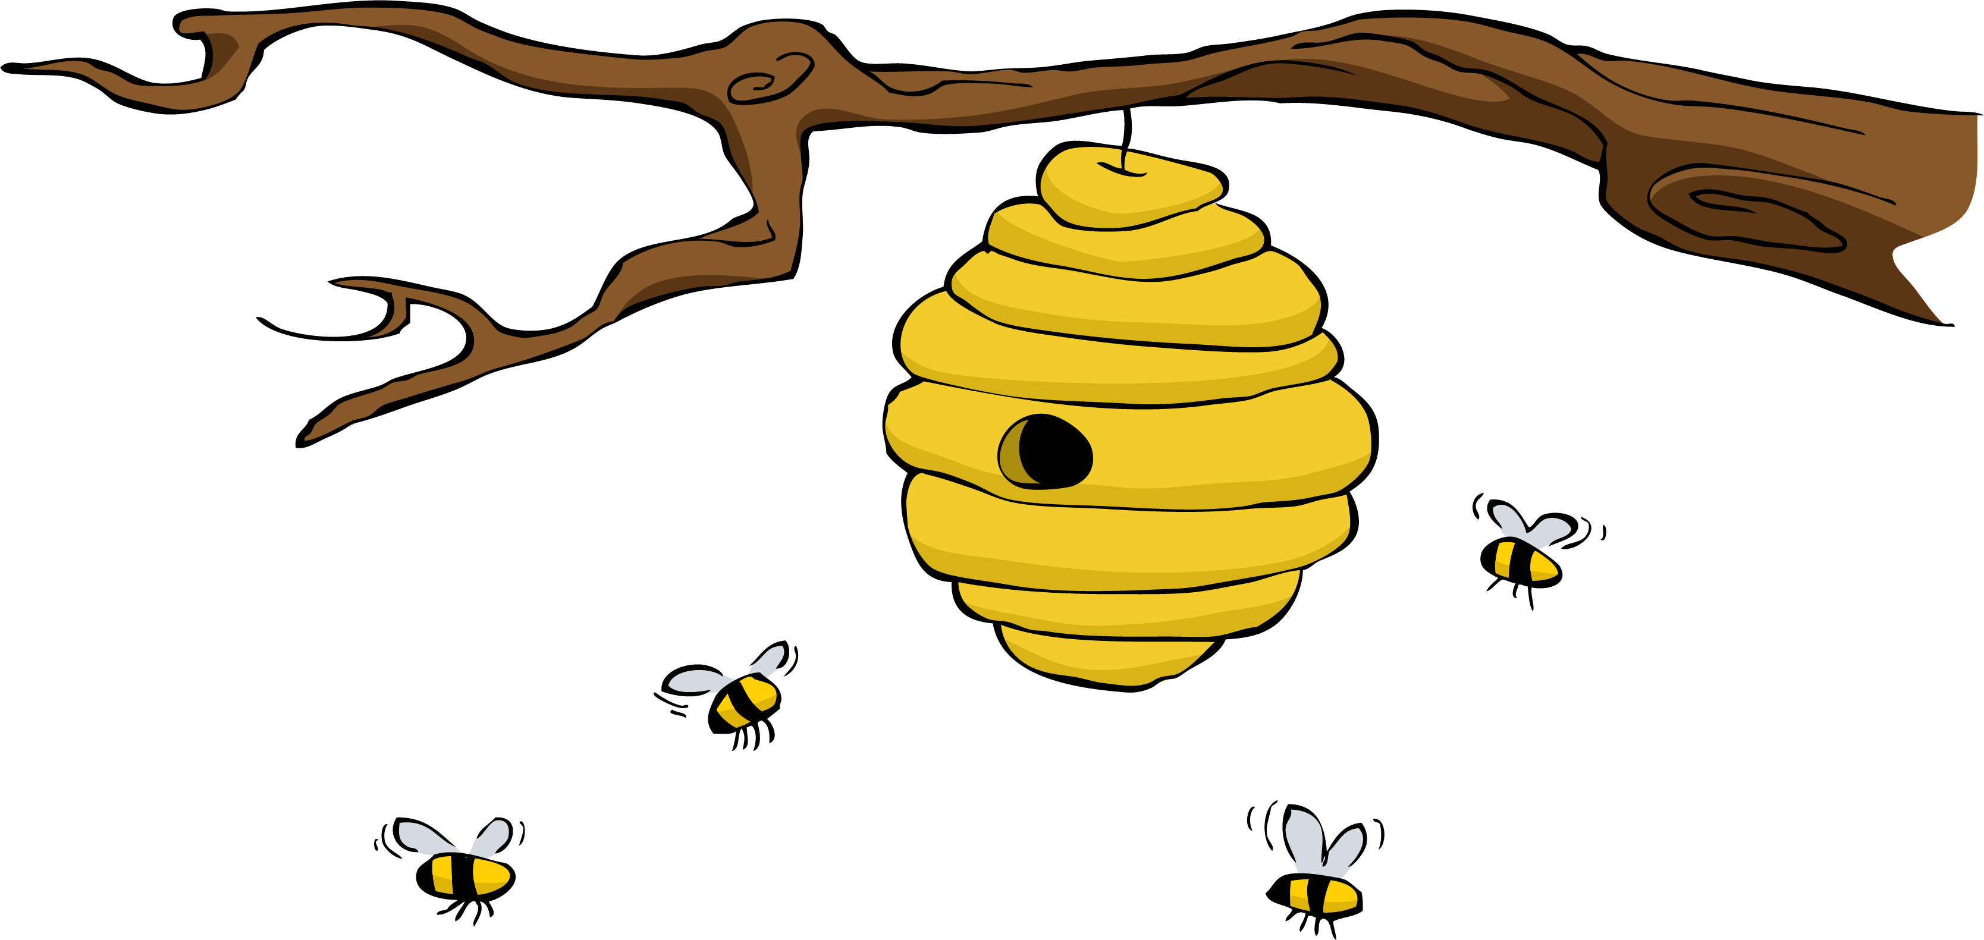
Skills
Relationship skills
Social awareness
“Kind words are like Honey.
Sweet to the soul
and
healthy for the body.”

Slide 5
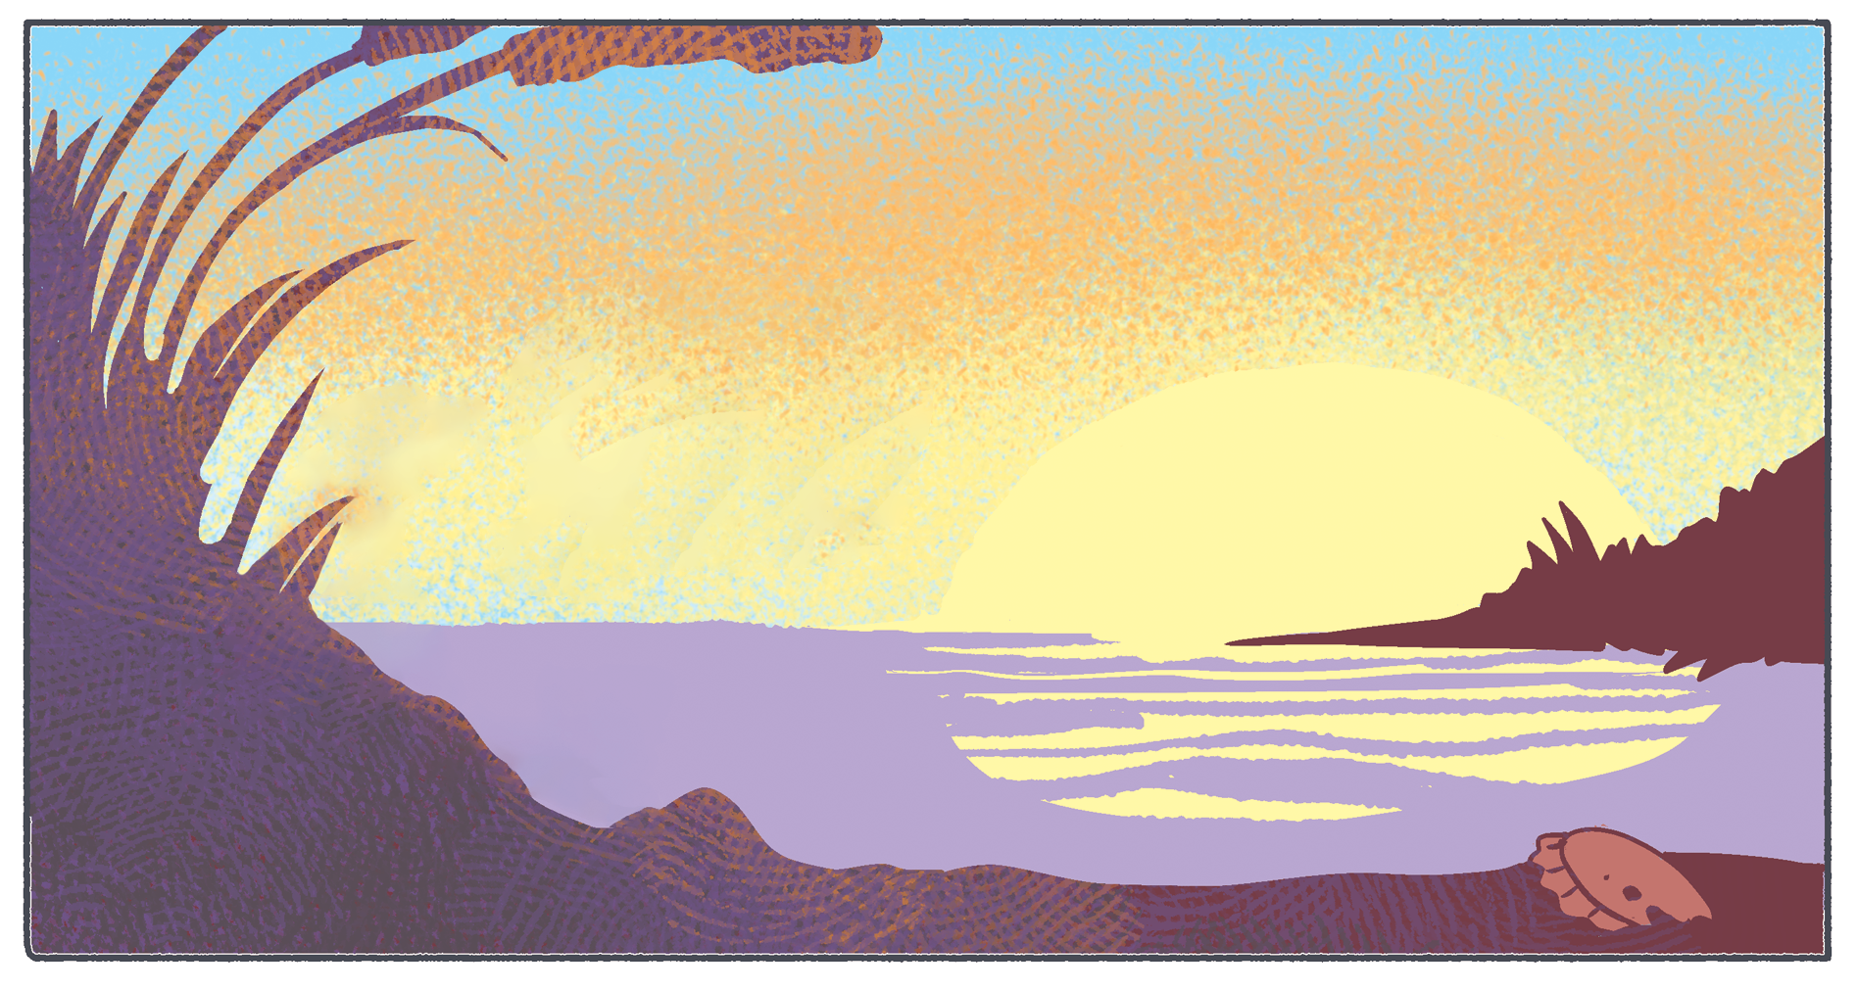
Opening Question
Is reflecting becoming easier?
“Wherever there is a human being, there is an opportunity for a kindness.“

Slide 6
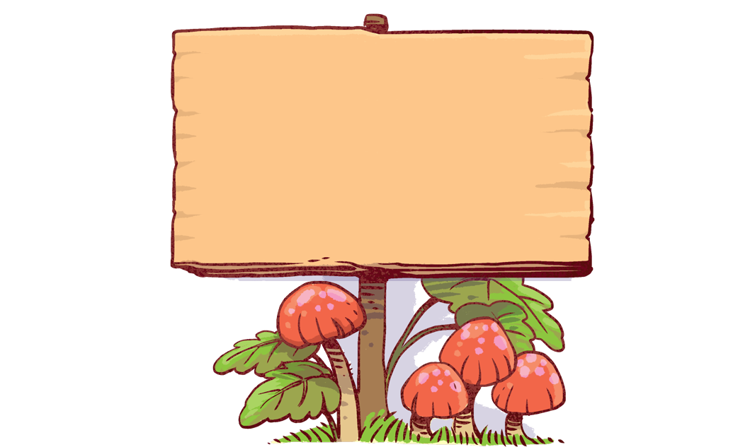
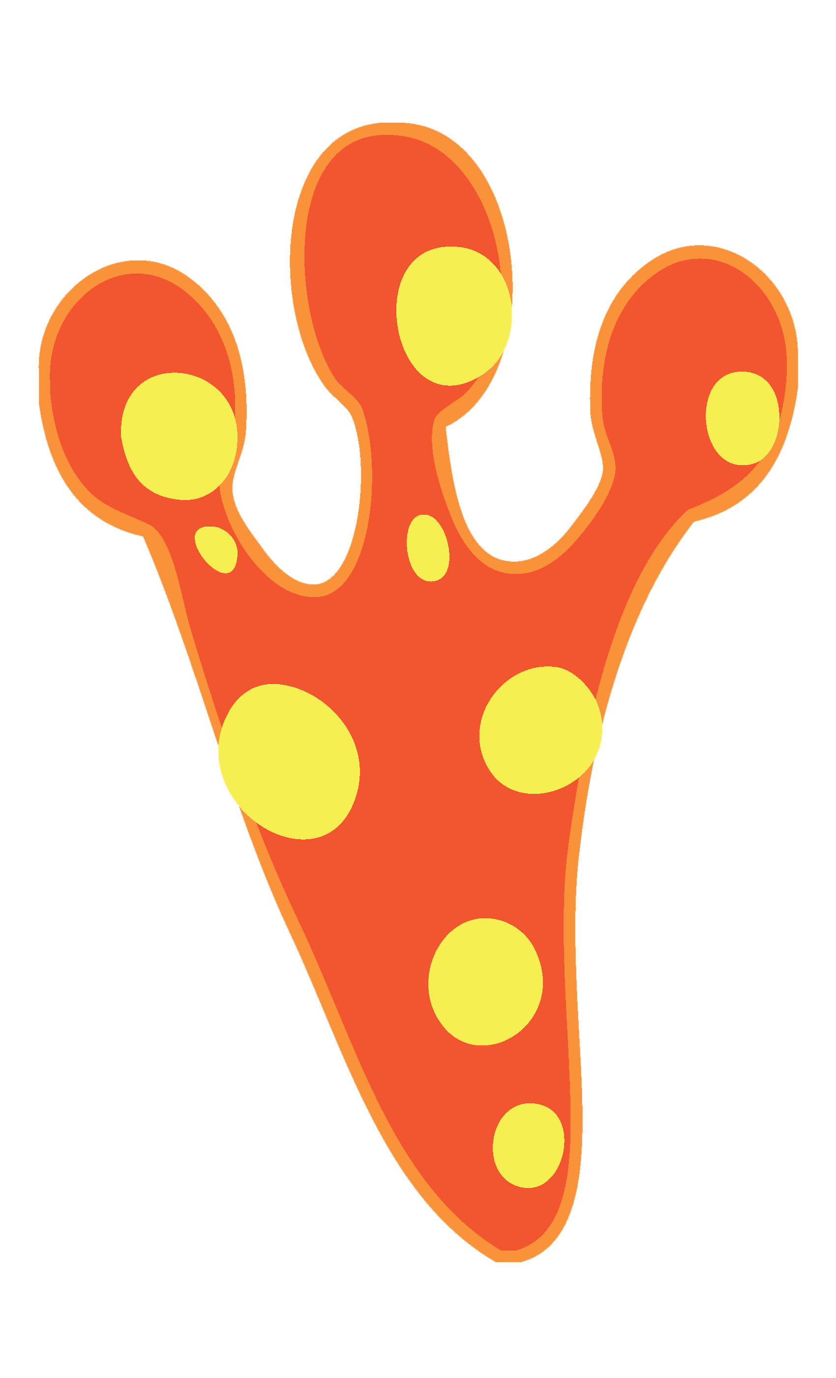
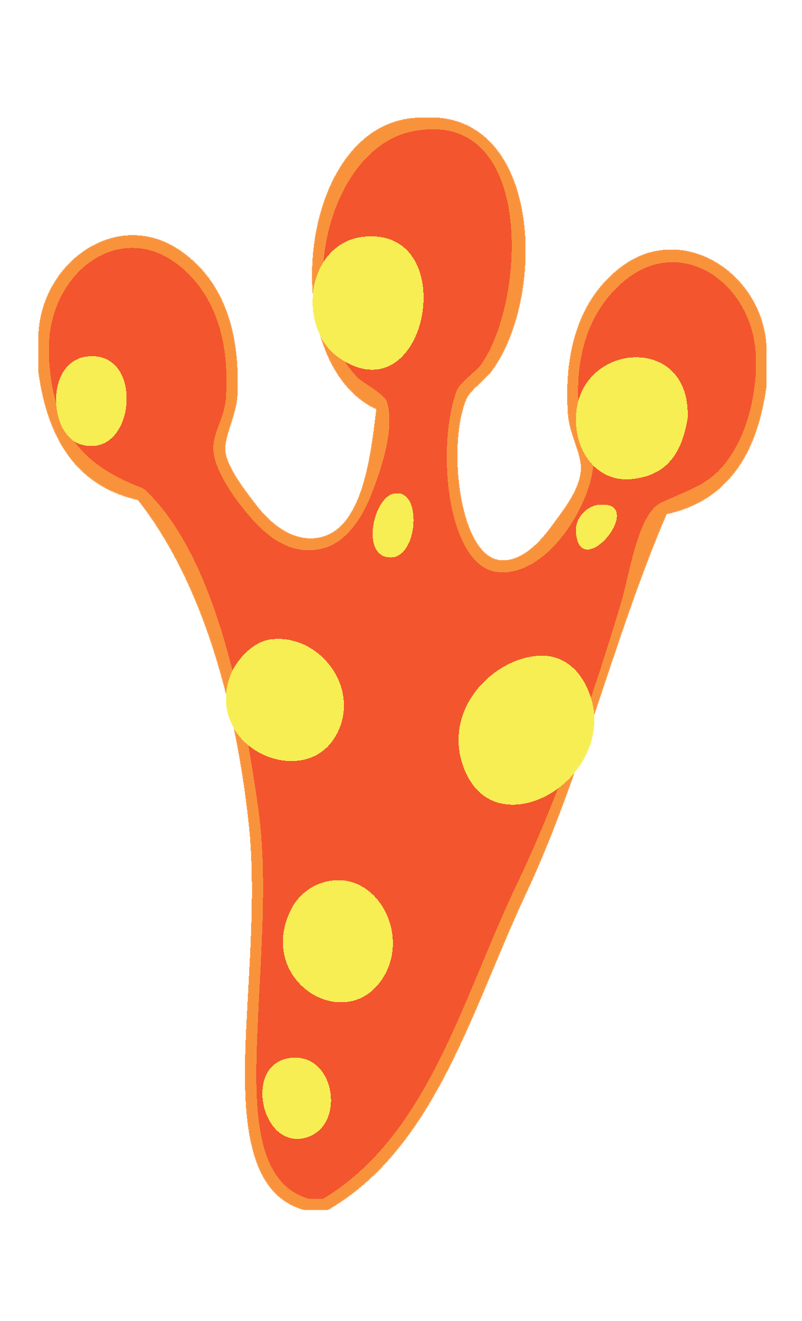
Thoughts
When we reflect, it can be just like looking in a mirror. Reflection is a tool we use to grow ourselves. We must think about what we have done, what we have said, and how it has changed our day. We can think about the way these things have affected us and how they have affected others.
We are going to look back at the way our 21-day
CAOK Challenge has impacted our day and our lives.
Does anyone feel like they are happier, knowing that
they intentionally sought out others and left a
positive impact on their day?
Because in the End,
Only
Kindness Matters

Slide 7
Activity
We are going to look back at the way our 21-day CAOK Challenge has impacted our day and our lives. There is a reflection section on the last page of the journal.
Not only are we going to do that, but we are going to develop a tool that others could use to show their understanding of CAOK.
Pick one that you have not done before in previous sections.
When I was a boy and would see scary things in the news, my mother would say to me, “Look for the helpers. You will always find people who are helping”.
~Fred Rogers

Slide 8
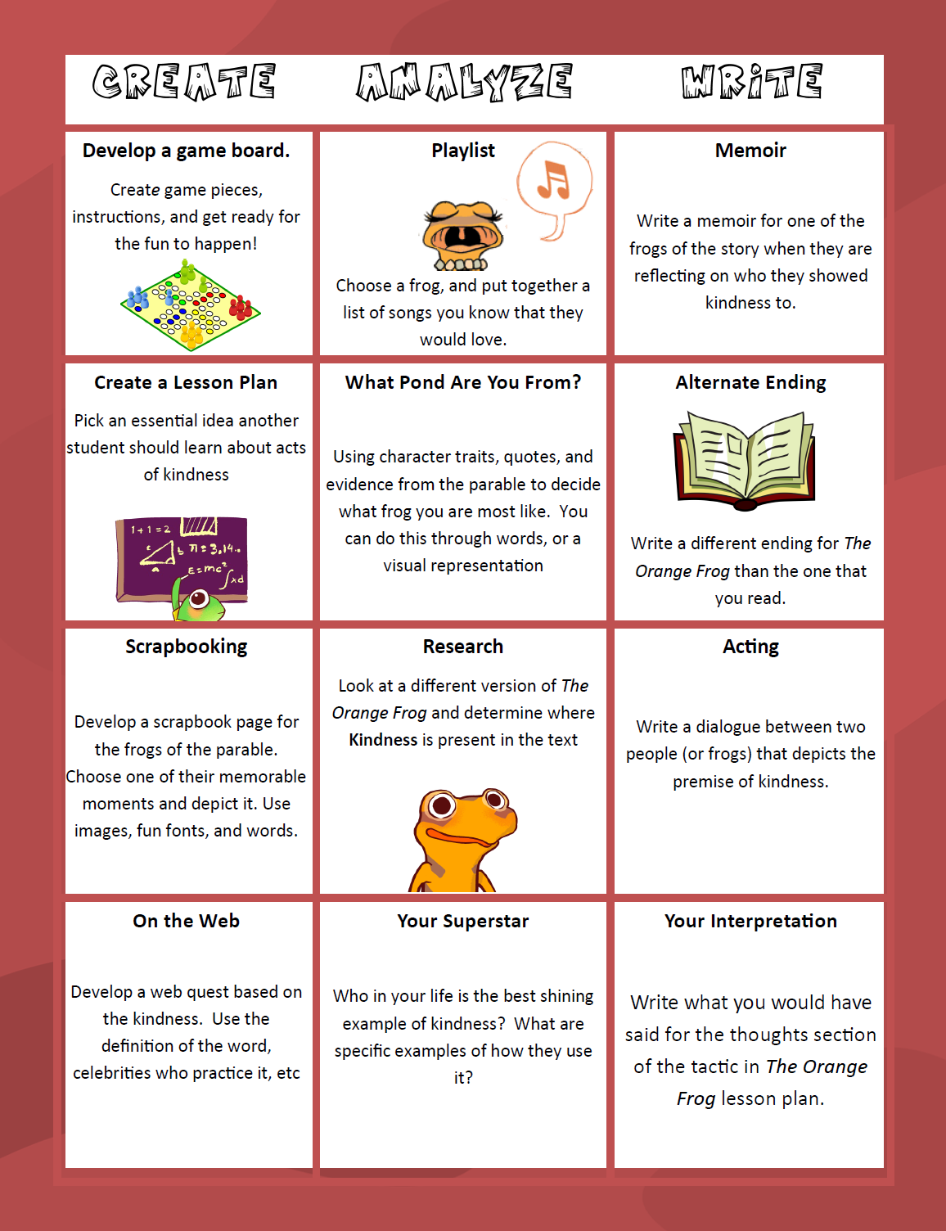

Slide 9
Bonus Question
How many people have you performed acts of kindness for during these past weeks and what was your favorite reaction from?

Slide 10
